Slide 1
Welcome to my Presentation

Slide 2
Presentation on Digital Logic Design
Presented By:
Name : Tushar Sarkar
Student ID: 18CSE035
Second Year First Semester
Department of CSE,BSMRSTU,
Gopalganj-8100.

Slide 3
Outline
Question
Explanation
Table 1
Table 2
Table 3
Table 4
Final Table
Circuit

Slide 4

My Question is 3
Implementation of the following Boolean function with one 4 x1 multiplexer and external gates.
F(A,B,C,D) = $\sum{(}$1,3,4,11,12,13,14,15)

Slide 5
Explanation
Connect inputs A and B to the selection lines.
The input requirements for the four data lines will be a function of variables C and D.
These values are obtained by expressing F as a function of C and D for each of the four cases when AB = 00, 01, 10, and 11.
These functions may have to be implemented with external gates.

Slide 6
Table 1
INPUT |  |  |  | OUTPUT
A | B | C | D | F
0 | 0 | 0 | 0 | 0
0 | 0 | 0 | 1 | 1
0 | 0 | 1 | 0 | 0
0 | 0 | 1 | 1 | 1
AB=00
F=D

Slide 7

Table 1
INPUT |  |  |  | OUTPUT
A | B | C | D | F
0 | 1 | 0 | 0 | 1
0 | 1 | 0 | 1 | 0
0 | 1 | 1 | 0 | 0
0 | 1 | 1 | 1 | 0
AB=01
F=$C^{′}D^{′}$
=${(C+D}^{′}$

Slide 8
Table 1
INPUT |  |  |  | OUTPUT
A | B | C | D | F
1 | 0 | 0 | 0 | 0
1 | 0 | 0 | 1 | 0
1 | 0 | 1 | 0 | 0
1 | 0 | 1 | 1 | 1
AB=10
F=CD

Slide 9
Table 1
INPUT |  |  |  | OUTPUT
A | B | C | D | F
1 | 1 | 0 | 0 | 1
1 | 1 | 0 | 1 | 1
1 | 1 | 1 | 0 | 1
1 | 1 | 1 | 1 | 1
AB=11
F=1

Slide 10
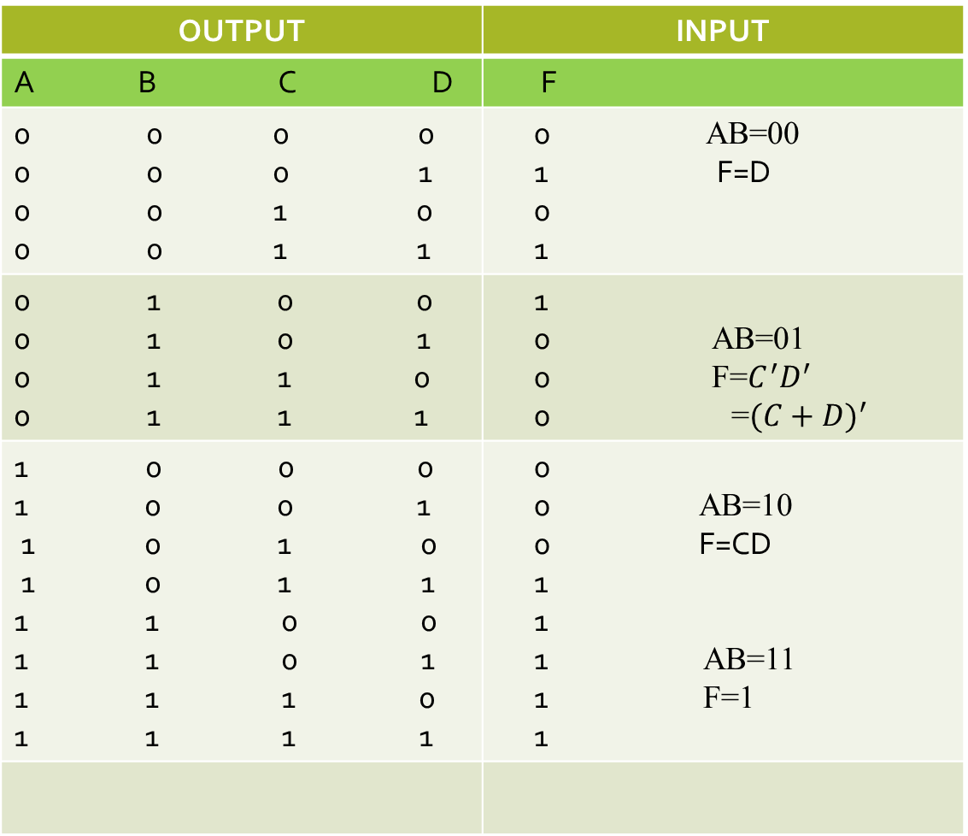
Final Table
OUTPUT | INPUT
A B C D | F
0 0 0 0 0 0 0 1 0 0 1 0 0 0 1 1 | 0 AB=00 1 F=D 0 1
0 1 0 0 0 1 0 1 0 1 1 0 0 1 1 1 | 1 0 AB=01 0 F=$C^{′}D^{′}$ 0 =${(C+D)}^{′}$
0 0 0 1 0 0 1 1 0 1 0 1 0 1 1 1 1 0 0 1 1 0 1 1 1 1 0 1 1 1 1 | 0 0 AB=10 0 F=CD 1 1 1 AB=11 1 F=1 1

Slide 11

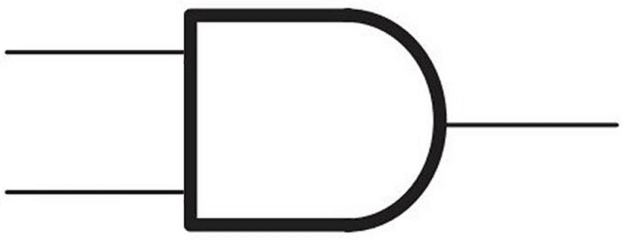
Circuit
A
B
C F
D
1
S1
S2
0
Y
1
2
3

Slide 12
Thank You

